Slide 1
Parallel Line Chart Ideas
1
2
Hex Colors (checked, Plotly does support HEX IDs)
______
______
______
______
______
3
4
5
Customized line colors, based on chapter figures (color on left, RGB on right)
Customized dashes, to increase visually impaired/color blind readability

Slide 2
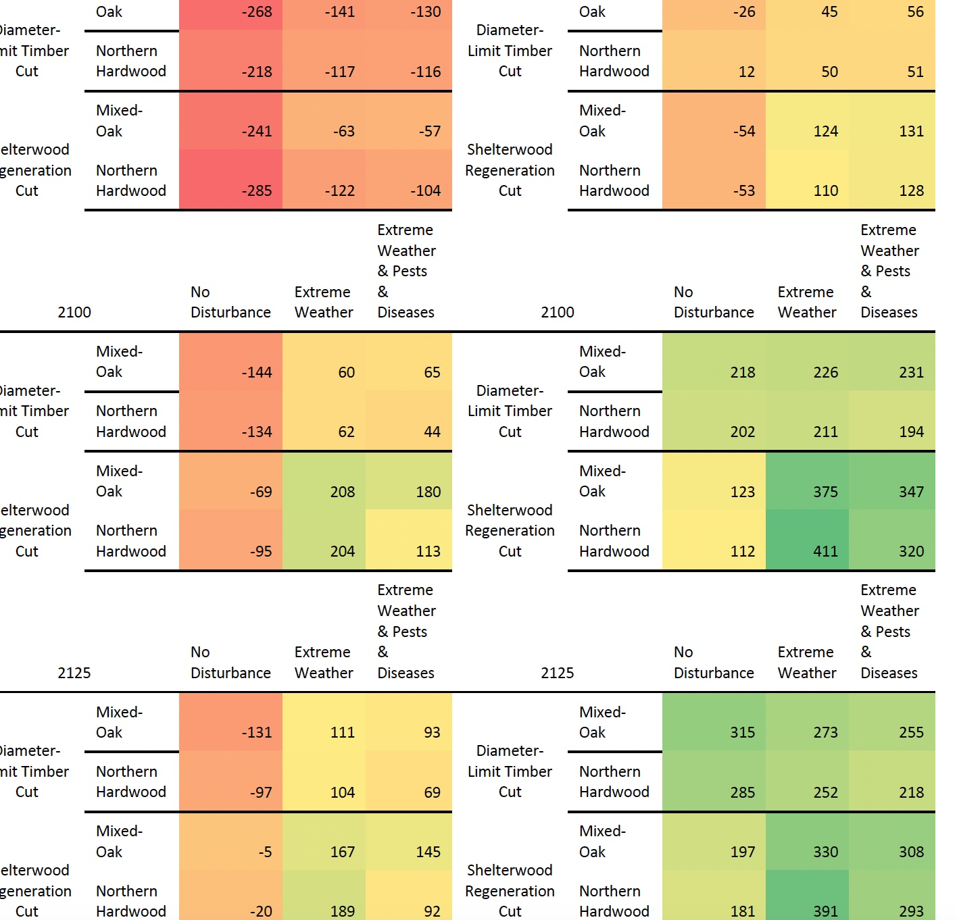

Slide 3
NE Forests
1
2
Hex Colors
2A8249
46B56D
A9D975
51924C
B3D69F
3
4
5

Slide 4
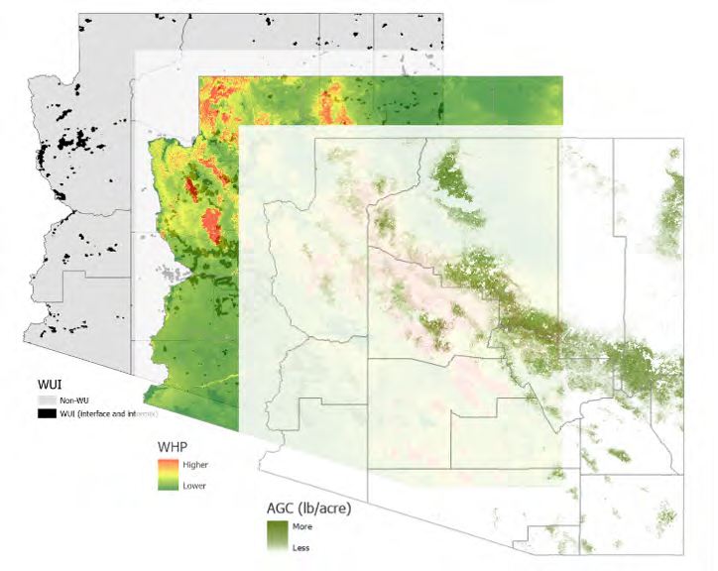

Slide 5
Western Forests
1
2
DD4F3D
FE7741
FFA94D
FDD749
F2F54C
3
4
5

Slide 6
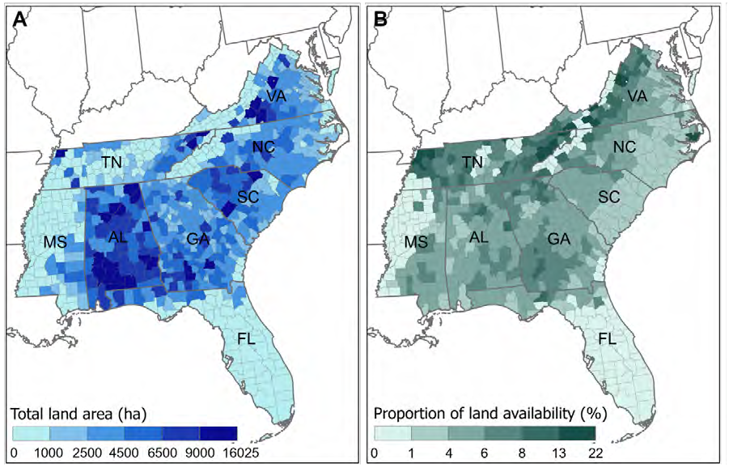

Slide 7
SE Forests
1
2
0F1E62
1B2CA9
016CD4
56B0DC
B9F8F1
3
4
5

Slide 8
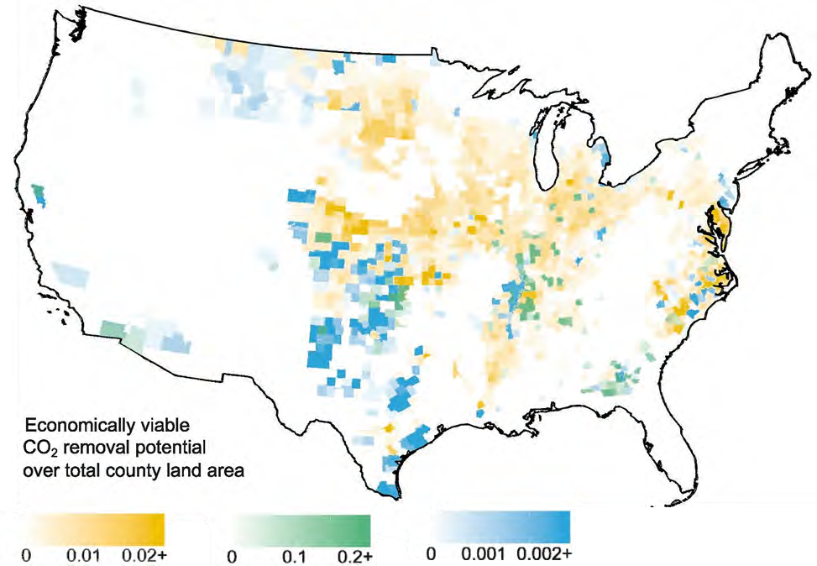

Slide 9
Cover Crops
1
2
2C9D75
1EB983
80CBA0
C4F2DB
E1F4E6
3
4
5

Slide 10
Perennial Carbon Crops
1
2
DCA402
EFB502
FFD859
F4D694
FEEDCC
3
4
5

Slide 11
Perennial Field Borders
1
2
1D92B3
009AD4
8CCBED
CAE8FF
E4F1F7
3
4
5

Slide 12
Geologic Carbon Storage
1
2
307312
3B9117
5FBA32
92CC74
A5EA85
3
4
5

Slide 13
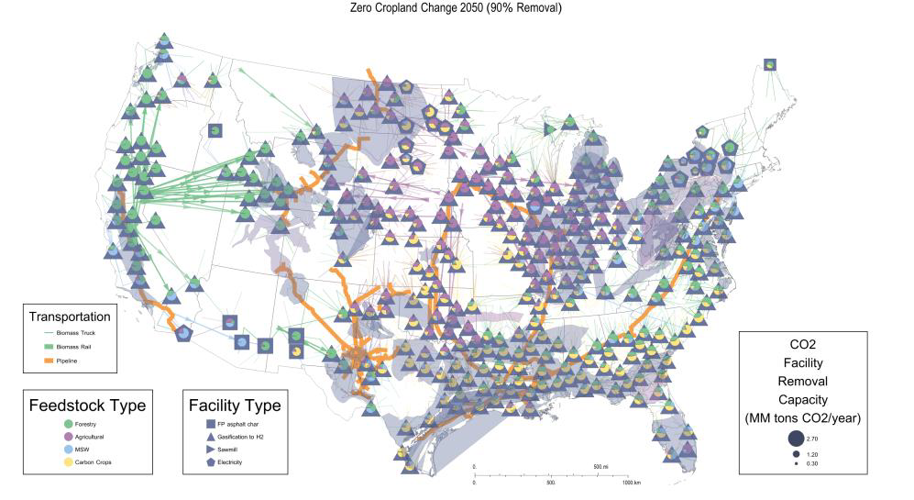

Slide 14
BiCRS Dry Waste
1
2
7DB28C
B5E0BF
E0F1DF
F5E786
EBD985
3
4
5

Slide 15
BiCRS Wet Waste
1
2
906E92
AD84AF
C395C6
E4AFE8
FCC1FF
3
4
5

Slide 16
BiCRS MSW
1
2
7A92AD
98B4D1
A1BEDE
B1D2F4
BADBFF
3
4
5

Slide 17
BiCRS Facilities
1
2
555C7C
727BA5
838EBE
9AA7E0
B0BFFF
3
4
5

Slide 18
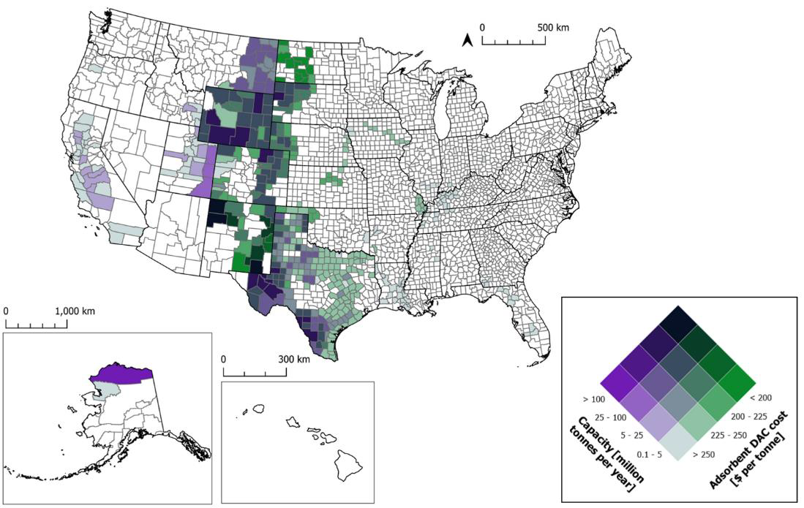
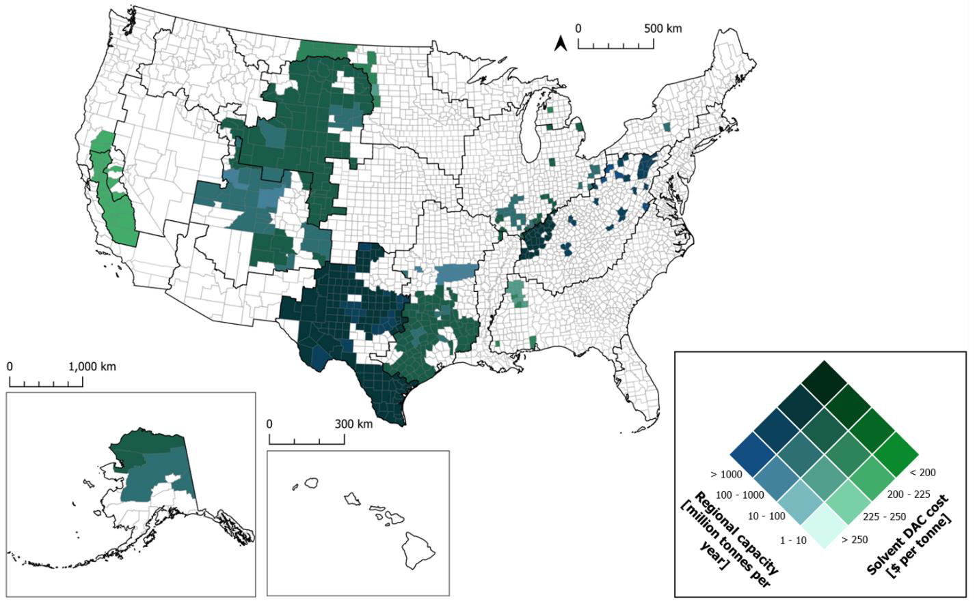

Slide 19
DAC (Adsorbent)
1
2
090F2B
5B1496
157026
9E6DD0
9DC9AE
3
4
5

Slide 20
DAC (Solvent)
1
2
Hex Colors
053114
1F5B84
177020
558CA8
8AD6AD
3
4
5

